Slide 1

Advanced Sentiment Analysis and Summarization Tool
Danny Boone, John Lattal, Benjamin Weideman, Ilyas Kussanov

Slide 2

Problem Statement
Financial data comes from so many sources it is overwhelming:
News Articles
Analyst Reports
Company Financial Reports
Other Large Documents
How can we effectively comb through all this data to know what is impacting a company’s stock price?

Slide 3

Project Objectives
Develop a News Sentiment Analysis Tool:
Analyze sentiment from news articles, financial reports, and other large documents
Feature Importance to Predict Stock Price Movement:
Identify and report the key factors that most significantly influence reactions and stock price movements
Explain Stock Price Movement Using News Articles:
Find relevant documents and references that could explain stock price movement
Deliver Comprehensive Analysis Report:
Produce detailed reports summarizing the findings

Slide 4
Dataset Description
VOLUME
- Earnings reports/transcripts, press releases, full-length articles from major financial news outlets, and stock performance data.
VELOCITY
- Data will be collected continuously as new financial reports are released and news articles are published.
VARIETY
Text documents like news articles, reports and news releases from different sources and formats. Chevron and industry competitors will be included.
VERACITY
High reputable financial news outlets and direct corporate financial disclosures.
VALUE
High value as it provides deep insights into market sentiments, financial performance, and competitive positioning within the oil and gas industry.

Slide 5
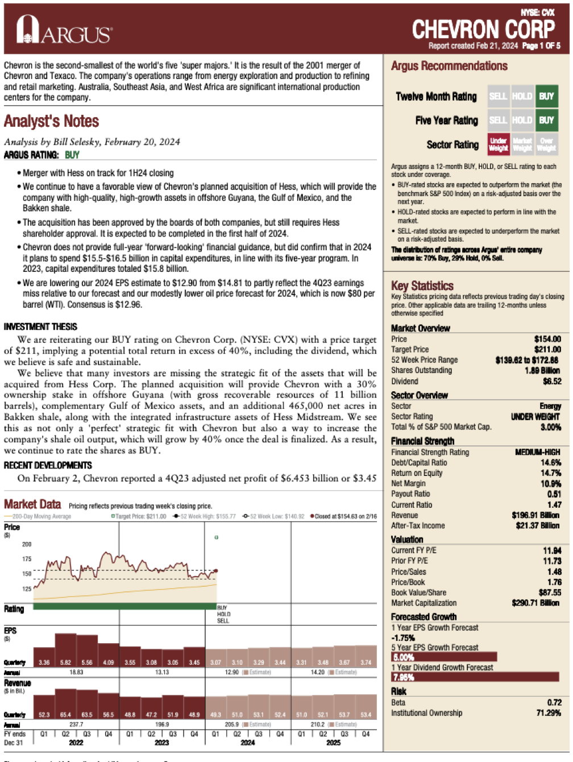
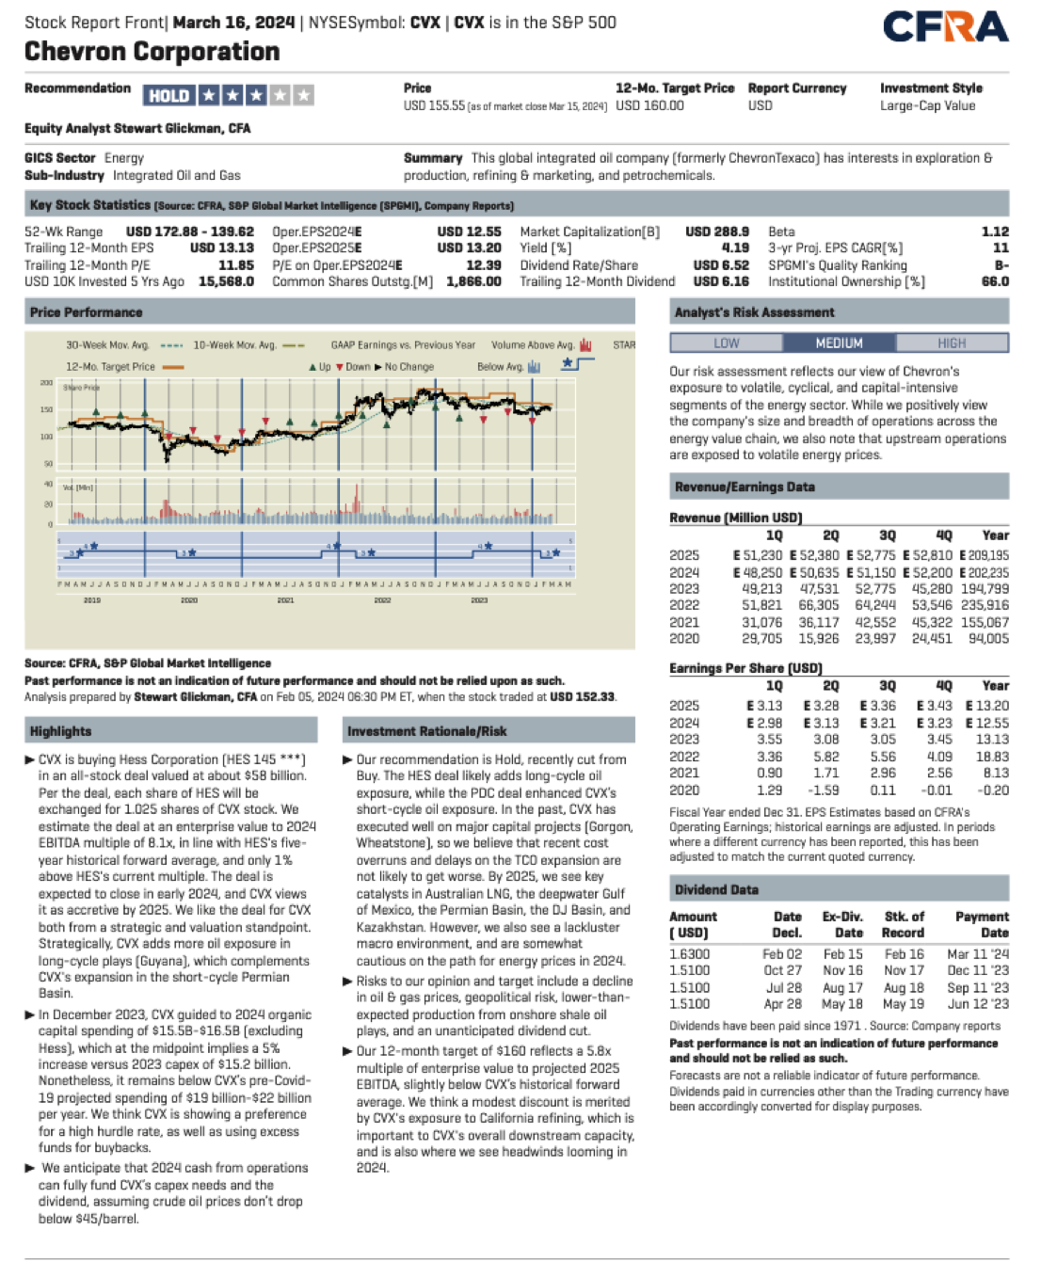
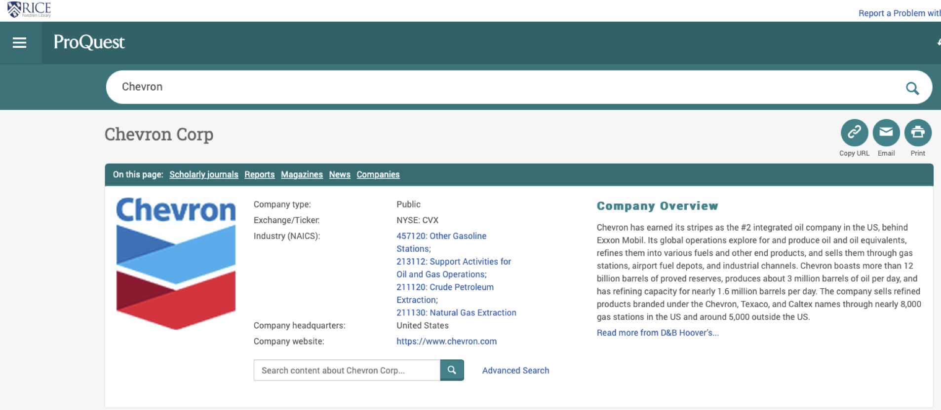

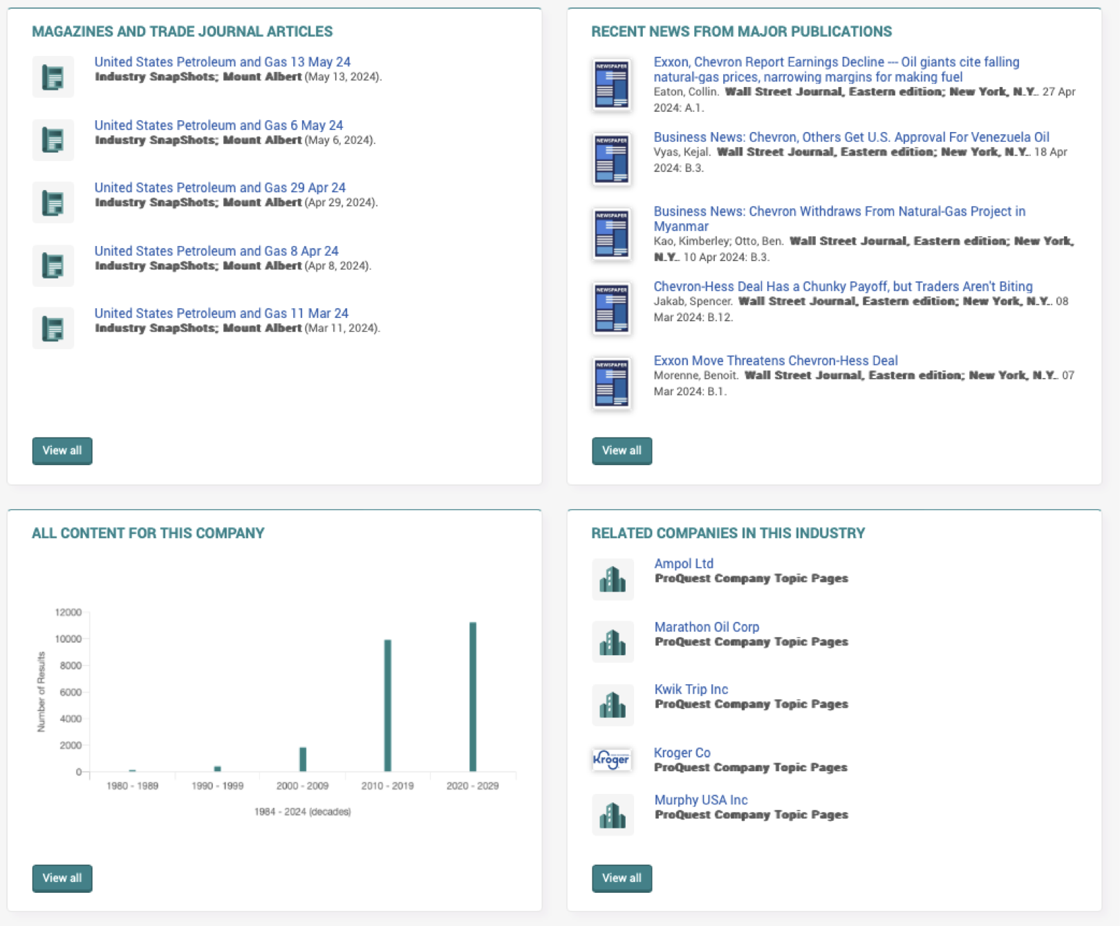
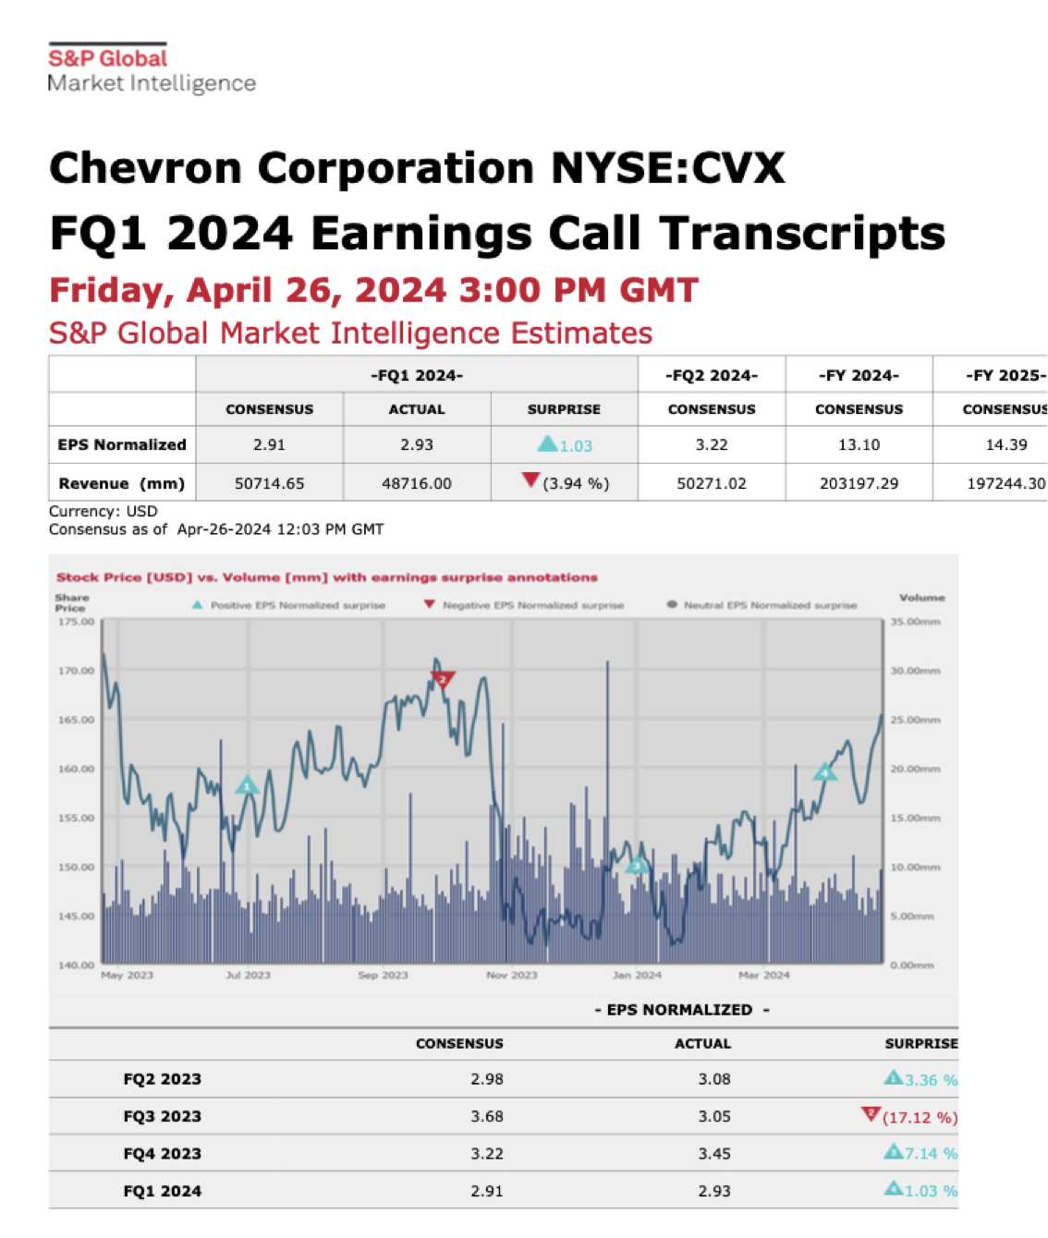
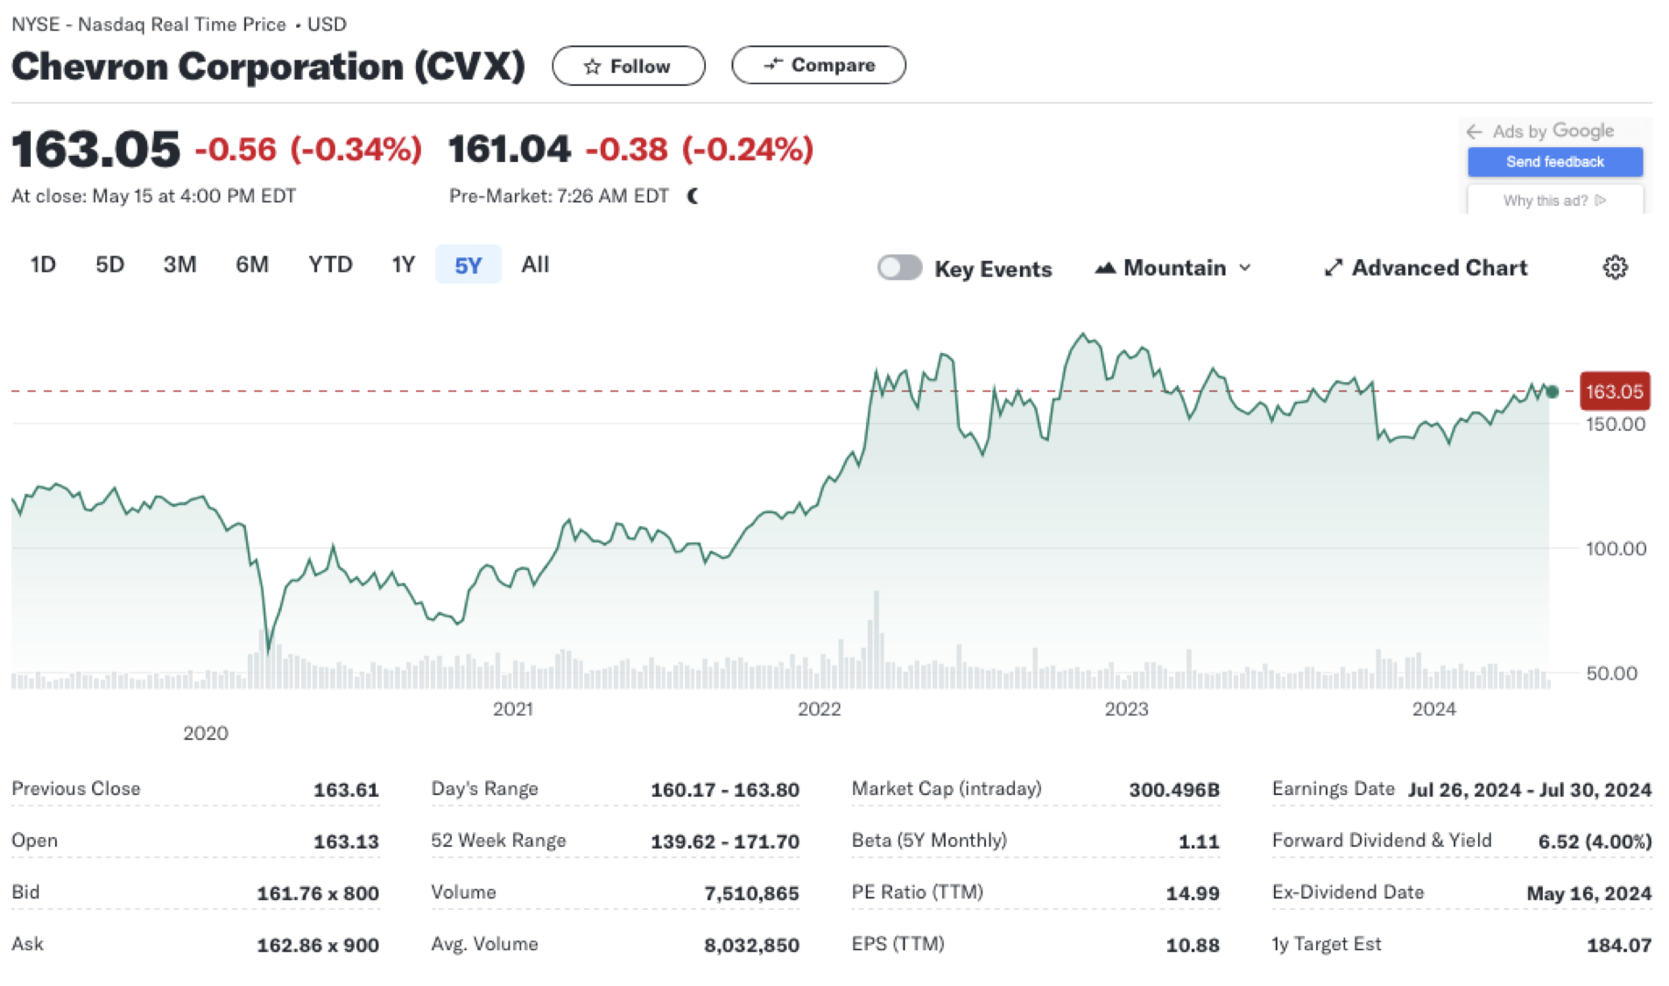
Dataset Examples:
Rice Resources
S&P Global Net Advantage: Analyst Reports
Standard & Poor’s Global NetAdvantage
ProQuest: News Articles
ProQuest One Business
Earnings Calls Transcripts
Data Formats:
PDF
URL /HTML
Tabular
Net Advantage Earnings
Yahoo Finance: Stock Performance
Data Range: 2019-Current
Compile all data sources to .csv format for cleaning/exploring
*All data compiled from Public data sources*

Slide 6



Pipeline Design
Sentiment Analysis
Custom Sentiment Categories
Fine-tuned Local LLM
Validated with ChatGPT / Gemini
Feature Importance
Predict Stock Movement Based on Sentiment
Determine Feature Importance
Data Collection
/ Wrangling
Data Exploration
Modeling
/ Validation
Download / Scrape Oil & Gas Financial News Articles
Ingest Data into CSV Format
Company Count
Article Statistics
Token Statistics
Three Sequential Models
Retrieval Augmented Generation
Interactive Dashboard
Vector Database Supported
ChatGPT / Gemini Powered

Slide 7







Timeline
Week 1
Initial Presentation
First Prototype
Beta version
Final release
Showcase
May
June
July
Kicking off report
Data Wrangling
Final report
&
Presentation
Midterm showcase
& report
Modelling
All done
Software
feedback
Midterm
feedback
EDA
Today
6
7
10
11
13-14
Week 1
15

Slide 8


rice.edu

Slide 9






Slide 10
Agenda Topics:
1. Can we meet every week Tuesday After Class?
o Can we dedicate an hour if needed?
2. Align on Project Workflow
3. Review Slide Deck
4. Decide on Presenters
Intro Ben
Docs John
Pipeline Danny
Schedule Ilyas
5. Where do we put our documents?
o Github vs shared drive?
Reports , slide deck etc. Google drive
rest in Github
6. Weekly Work Assignments
o Project Management Stuff
§ Create Document to Hold Agendas, Action Items, Project Timeline, Documentation/Notes etc…
Project Management - Ben
o Finish Scraping Data
o LLM Fine Tuning / Prompt Engineering / Refine Categories
Prompt Engineering - Ilyas
Data collection - John
Exract text into csv and automate process - Danny
Data Visualization and interactivity: find interactive graph
o Make Workflow Pretty
Danny

Slide 11
Pipeline Design
DATA
COLLECTION/
WRANGLING
Financial News Articles
10-K Annual Reports & 10-Q Quarterly Reports
Financial Analyst Summaries
Indexing articles into cvs form
DATA EXPLORATION
Number of articles (total, per year, quarterly)
articles per company
max tokens, average tokens…
word cloud
Define Sentiment Categories
Prompt Engineering
Fine Tuning if Needed
Validate with ChatGPT / Gemini
MODELLING
VALIDATION
SENTIMENT ANALYSIS
WITH LOCAL LLM
FEATURE IMPORTANCE
MODELLING
Create stock price prediction model to determine feature importance for stock price. (Up/Down)
RETRIEVAL AUGMENTED GENERATION
With ChatGPT / Gemini
VALIDATION
Validate Sentiment with ChatGPT / Gemini

Slide 12
Pipeline Design
DATA
COLLECTION
DATA WRANGLING
EDA
Sources
APIs and Scraping
Cleaning
Transformation
Text processing
Statistics
Visualization
FEATURE ENGINEERING
MODELLING
EVALUATION
DEPLOYMENT
Sentiment categories
Text features
ChatGPT and Analogues for Summarization
ChatGPT and Analogues for Q&A
Sentiment Analysis
Summarization Quality
Q&A Accuracy
Comparative Analysis
Interactive Dashboard
API Development

Slide 13
Pipeline Design
DATA
COLLECTION
/ EDA
DATA WRANGLING
FEATURE ENGINEERING
Financial News Articles
10-K Annual Reports & 10-Q Quarterly Reports
Financial Analyst Summaries
Index Data in CSV form
Define Sentiment Categories
Define Sentiment Options
CREATE FEATURES WITH LOCAL LLM
STOCK MODELING WITH NEW FEATURES
VALIDATION
DEPLOYMENT
Prompt Engineering
Fine Tuning if Needed
Validate with ChatGPT / Gemini
Predict Stock Performance
Evaluate Most Impactful Features
Compare Accuracy with New Features
Interactive Dashboard

Slide 14

Importance
Ok, Let’s see what insights the tool can provide me.
What is financial targets?
What is production targets?
New Energy?
Discovery?
How is our competitor doing?
Report sentiment analysis

Slide 15
